Slide 1
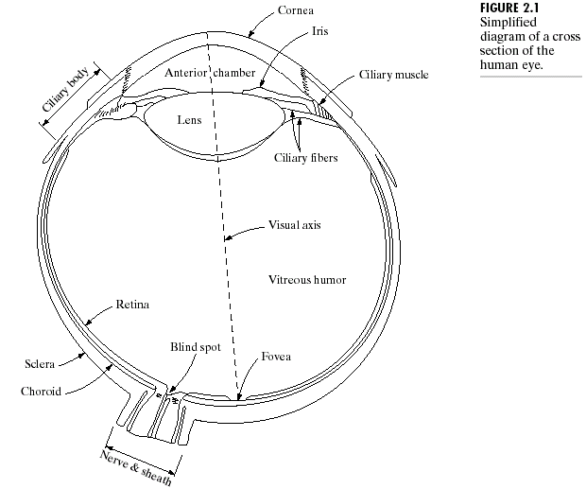
Human Visual Perception
Prof. Suresh Pabboju

Slide 2
The Human Eye
Diameter: 20 mm
3 membranes enclose the eye
  Cornea & sclera
  Choroid
  Retina
Prof. Suresh Pabboju

Slide 3
The Choroid
The choroid contains blood vessels for eye nutrition and is heavily pigmented to reduce extraneous light entrance and backscatter.
It is divided into the ciliary body and the iris diaphragm, which controls the amount of light that enters the pupil (2 mm ~ 8 mm).
Prof. Suresh Pabboju

Slide 4
The Lens
The lens is made up of fibrous cells and is suspended by fibers that attach it to the ciliary body.
It is slightly yellow and absorbs approx. 8% of the visible light spectrum.
Prof. Suresh Pabboju

Slide 5
The Retina
The retina lines the entire posterior portion.
Discrete light receptors are distributed over the surface of the retina:
  cones (6-7 million per eye) and
  rods (75-150 million per eye)
Prof. Suresh Pabboju

Slide 6
Cones
Cones are located in the fovea and are sensitive to color.
Each one is connected to its own nerve end.
Cone vision is called photopic (or bright-light vision).
Prof. Suresh Pabboju

Slide 7
Rods
Rods are giving a general, overall picture of the field of view and are not involved in color vision.
Several rods are connected to a single nerve and are sensitive to low levels of illumination (scotopic or dim-light vision).
Prof. Suresh Pabboju

Slide 8
Receptor Distribution
The distribution of receptors is radially symmetric about the fovea.
Cones are most dense in the center of the fovea while rods increase in density from the center out to approximately 20% off axis and then decrease.
Prof. Suresh Pabboju

Slide 9
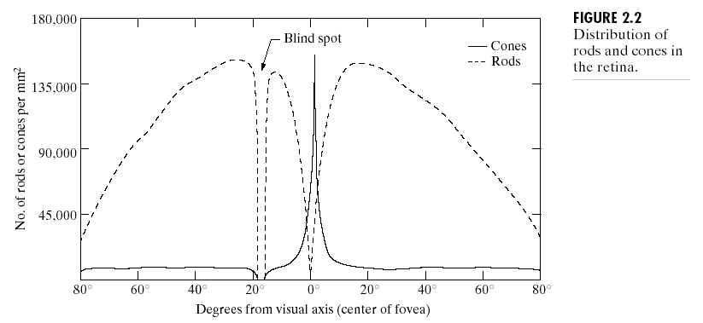
Cones & Rods
Prof. Suresh Pabboju

Slide 10
The Fovea
The fovea is circular (1.5 mm in diameter) but can be assumed to be a square sensor array (1.5 mm x 1.5 mm).
The density of cones: 150,000 elements/mm² ~ 337,000 for the fovea.
A CCD imaging chip of medium resolution needs 5 mm x 5 mm for this number of elements
Prof. Suresh Pabboju

Slide 11
Image Formation in the Eye
The eye lens (if compared to an optical lens) is flexible.
It gets controlled by the fibers of the ciliary body and to focus on distant objects it gets flatter (and vice versa).
Prof. Suresh Pabboju

Slide 12
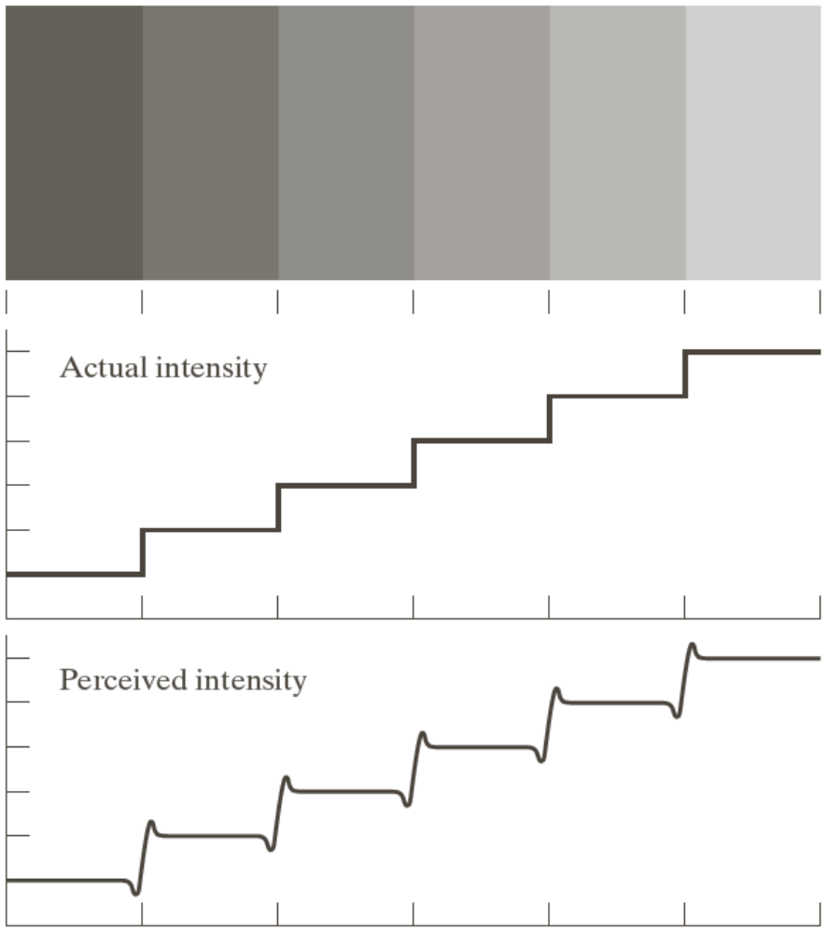
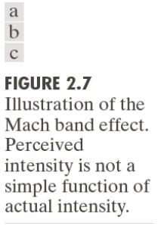
Mach Band Effect
Prof. Suresh Pabboju

Slide 13
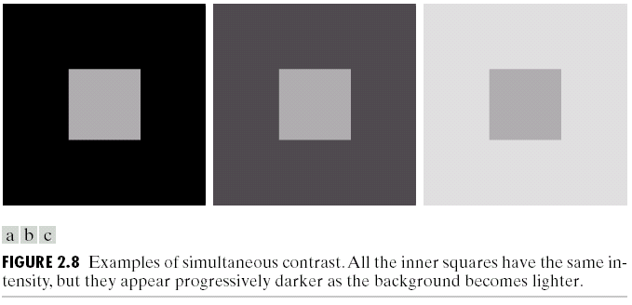
Simultaneous Contrast
Prof. Suresh Pabboju

Slide 14
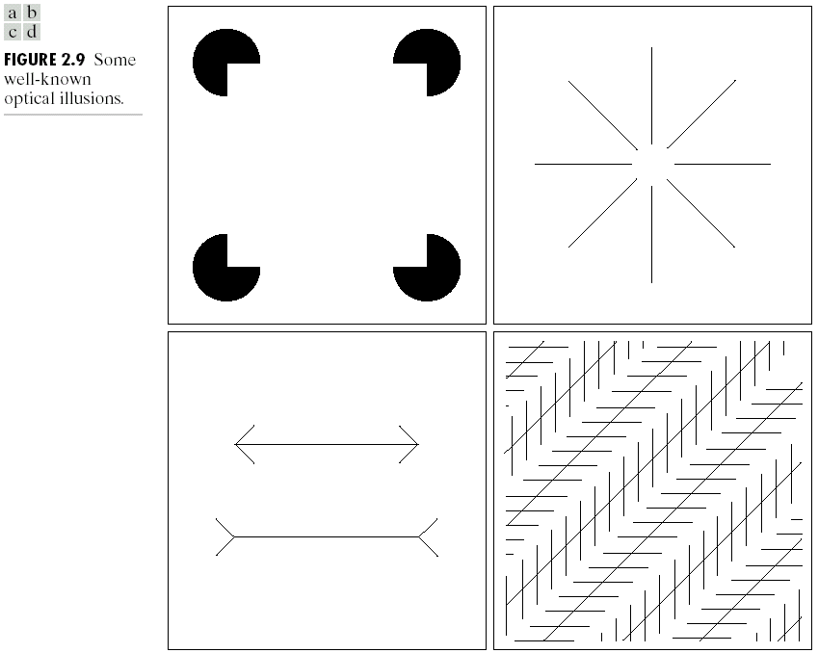
Optical Illusions
Prof. Suresh Pabboju

Slide 15
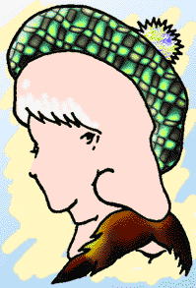
Prof. Suresh Pabboju

Slide 16

Prof. Suresh Pabboju

Slide 17
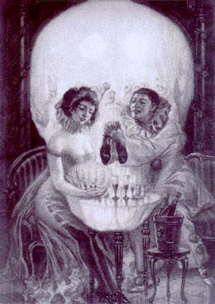
Prof. Suresh Pabboju

